Slide 1
Robotic Club Project’s Proposal
Interactive LED screen

Slide 2
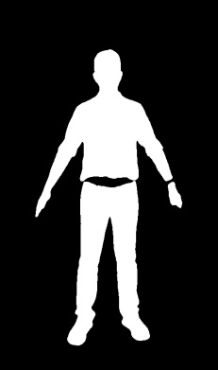
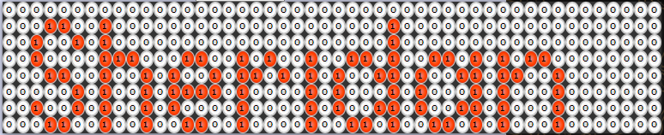
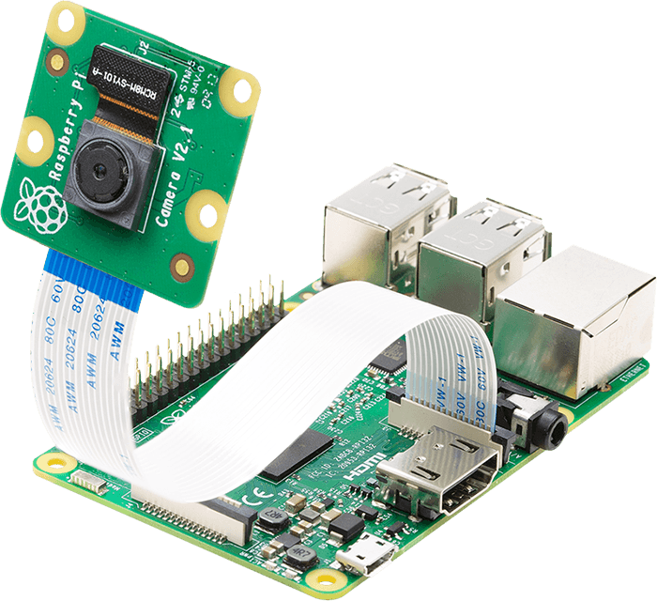
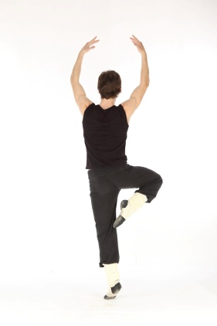


Notes:
{B000000000000000000000000000000000000000000000000,
B000110010000000000000000000010000000000000000000,
B001001010000000000000000000010000000000000000000,
B001000011100011001010010011010011010101100000000,
B000110010010100101101010100110100110110010000000,
B000001010010111101000010100010100010100010000000,
B001001010010100001000010100110100110100010000000,
B000110010010011001000010011010011010100010000000}

Slide 3
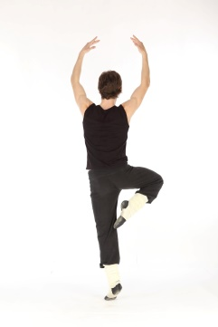


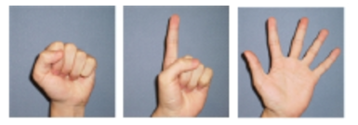
System Overview
Rasberry PI and Camera
LED panel
Using open CV to get the human body/hand
Notes:
{B000000000000000000000000000000000000000000000000,
B000110010000000000000000000010000000000000000000,
B001001010000000000000000000010000000000000000000,
B001000011100011001010010011010011010101100000000,
B000110010010100101101010100110100110110010000000,
B000001010010111101000010100010100010100010000000,
B001001010010100001000010100110100110100010000000,
B000110010010011001000010011010011010100010000000}

Slide 4
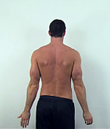


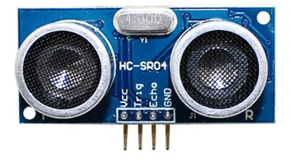

Slide 5
User case (1)
Take picture of human body
Get contour of human body by using Raspberry Pi and OpenCV library
Display the contour on LED panel in real-time
Allow user play some interactive game such as Tetris, Snake, Rock paper scissors, Dunk Ball … etc

Slide 6
Reference libraries
Hand Gesture Recognition
Human Gesture Recognition

